Slide 1

KYC , Networking, Skills
By:
Mr. Mukesh Mahay

Slide 2
What comprises an interview?
PPTalk
Pre preparation
Job Description
Your as a candidate
Types of interviews
Roles and Responsibilities
Expectations of Interviewer

Slide 3
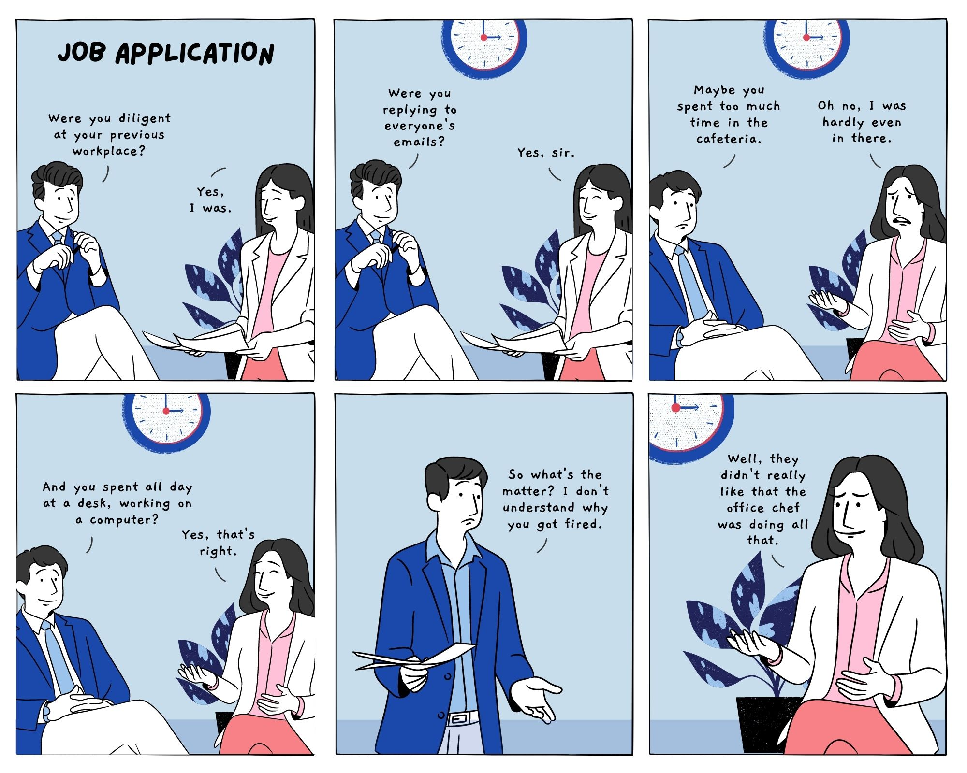
How skills and job role are important

Slide 4
Pre Placement preparations
Understand the process
Prepare the CV
Check the venue and other details
Grooming and etiquette

Slide 5
Poll
Is it ok to tell self weakness if interviewer asks ?
Yes
No

Slide 6






KYC (Know your company)
What all may be considered
Company Profile:
Leadership :
History/Journey:
Net Sales :
Number of Employees
Vision/Mission/Values
Products/services
Clients/Customers/Reach/ competitors

Slide 7
Job description
A job description summarizes the essential responsibilities, activities, qualifications and skills for a role. Also known as a JD, this document describes the type of work performed. A job description should include important company details — company mission, culture and any benefits it provides to employees.

Slide 8
Example….
As a Data Scientist, you will be responsible for modeling complex problems, discovering insights and identifying opportunities through the use of statistical, machine learning, algorithmic, data mining and visualization techniques. You will need to collaborate effectively with internal stakeholders and cross-functional teams to solve problems, create operational efficiencies, and deliver successfully against high organizational standards.
Responsibilities: · Use predictive analytics and machine learning techniques to solve complex problems and drive business decisions. · Employ the appropriate algorithms to discover patterns of risks, abuse and help reduce bad debt · Design experiments, test hypotheses, and build actionable models to optimize BRP operations · Solve analytical problems, and effectively communicate methodologies and results · Build predict models to forecast risks for product launches and operations and help predict workflow and capacity requirements for BRP operations · Draw inferences and conclusions, and create dashboards and visualizations of processed data, identify trends, anomalies · Work closely with internal stakeholders such as business teams, engineering teams, and partner teams and align them with respect to your focus area

Slide 9
Pre Placement Talk
This is one of the step towards the interview, the respective members of the team for hiring interacts with you
Be on time, LISTEN TO THEM CAREFULLY
Always ask questions when prompted to ask
Always be ready with grooming and timely presence

Slide 10
Your Introduction
What all points can be included and How?
The following, non-exhaustive, list has the more common skills and competencies that you may be asked to demonstrate:
• Adaptability
• Communication
• Conflict management
• Creativity and Innovation
• Decisiveness/Relocation
• Delegation
• External awareness
• Flexibility
• Influencing
• Integrity/Ethics
• Leadership
• Organisational awareness
• Resilience and tenacity
• Risk taking
• Team work
Remember introduction is all about branding and highlighting you as a capable person
Skills, certifications, projects, internships, USP, Perspectives etc.
****IT HAS TO BE CRISP , CLEAR***

Slide 11
Art of asking questions
This situation comes when the interviewer give option to the candidate for questions . It can be in pre placement talk and at the end of the interview round.
. May I get to know the tasks which are requiring team work?
. What are the possible aspect for innovative work ?

Slide 12
Different types of interviews
Structured Interview: The interview in which preset standardized questions are used by the interviewer
Unstructured Interview: The unstructured interview is one that does not follow any formal rules and procedures. The discussion is free-flowing
Mixed Interview: It is a combination of structured and unstructured interview, wherein a blend of predetermined and spontaneous questions are asked by the interviewer to the job seeker.
Behavioural Interview: It is concerned with a problem or a hypothetical situation, given to the candidate with an expectation that he/she would solve situation problem
Stress Interview: A number of harsh, rapid-fire questions are put to the interviewee with intent to upset him. It seeks to know, how the applicant will respond to pressure.
One to one Interview: The most common interview type , taking part in the face to face discussion, in order to transfer information.
Panel Interview: Panel interview is one, in which there is a panel of interviewers, i.e. two or more interviewers, All the members of the panel are different representatives of the company. When one interviewee and many interviewer are involved it is Group Interview
Telephonic Interview: Telephonic interview is one that is conducted over the telephone.
Video Interview : Video interview where in it is conducted on platforms like Skype, Google meet etc.

Slide 13
Competency Interviews
It is part of the interview process, where in the competencies are assessed
Projects –Your hard skills, soft skills(Aim , details, learning outcomes)
Workshops(learnings and objectives)
Certifications
Technical questions
If any non technical

Slide 14
CV
Do’s of CV writing
- Make your contact details i.e. the phone no. and e-mail address available at the very beginning of your CV
- Use a formal e-mail address (preferably a combination of your first and last name) rather than using an e-mail address like casual@xyz.com
- Your career summary should attract them to read the CV
- If you have got work experience, keep a focus of your CV on your experience, responsibilities and achievements, recent on top
- Use impactful words which demonstrate you in control of things.
- Rank the achievements in order of recent on the top
- Write about your interests out of work. They demonstrate your personal qualities./Skills/Certificatons/
- CV is a formal document. Use white or light colored A4 size paper and formal fonts.
Don’ts
CV on top. The reader knows that it’s a CV. You don’t need to mention it. - Lies about your candidature in CV are highly unadvisable. They may get you the entry but are not difficult to find out - Flashy fonts and colourful or glossy paper. CV is a formal document, keep it simple. - NO Borders/tabular forms - Usage of ‘I’, my’. They make you sound egomaniac. - Spelling mistakes and grammatical errors. They convey your lazy and not serious attitude. - Abbreviations or jargons which HR people might not understand. - Right alignment of the CV content

Slide 15

Notes:
Thank you and see you soon!

